Slide 1

Designing a Dapp for Bicycle Enthusiasts on Solana
Join us on a ride towards the future with our innovative decentralized application that will revolutionize the cycling community. Let's explore the potential of the Solana blockchain and how it can improve your cycling experience.

Slide 2
The Target Audience
Passionate Cyclists 🚴
Tech-Savvy Users 💻
Community Builders 🤝
We're targeting users who are comfortable with technology and understand how blockchain can provide unique opportunities for improving the cycling industry.
Our dapp is designed for individuals who have a deep love for cycling and want to enhance their experiences through innovative technology.
We want to appeal to users who are interested in building a community around their shared love for cycling and who see the value in decentralized platforms.

Slide 3
Designing the Dapp
1
Interactive Maps 🗺️
Our dapp will provide users with access to interactive maps that will allow them to discover new cycling routes and see real-time information about existing ones.
Rewards System 🎁
2
Our dapp will incentivize users to record their rides by offering rewards for completing challenges, accumulating miles, and connecting with other cyclists in the community.
3
Social Integration 🤝
Our dapp will allow users to connect with each other and share their cycling experiences on social media platforms through seamless integration.

Slide 4


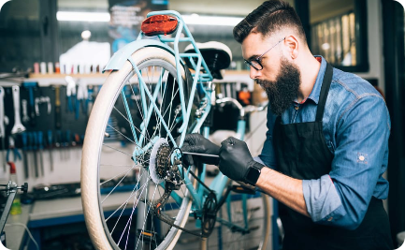
Development Process
Smart Contract Development
Collaborative Development
Maintaining and Scaling
We will ensure that our dapp is highly maintainable and scalable, allowing us to add new features and technologies as needed to meet the evolving needs of our users.
We will write smart contracts that will power the functionalities of our dapp, including the rewards system and social integration features.
Our team will work together to build and test our dapp, focusing on delivering an efficient, user-friendly and bug-free platform.

Slide 5

Technical Solution Implementation
1
Solana Blockchain Integration
2
Back-End Infrastructure
We will leverage the speed and scalability of Solana to ensure that our dapp can efficiently and effectively handle large volumes of traffic and transactions.
We will build a reliable back-end infrastructure to drive the functionalities of our dapp and ensure that it can be easily maintained and updated as needed.
3
User-friendly Front-End
We will design an intuitive and visually appealing front-end that allows users to easily and conveniently access the features and tools of our dapp.

Slide 6
Benefits of the Dapp
Enhanced Cycling Experience 🚴‍♂️
Decentralized Platform 🌐
Community Building 🤝
Our dapp will empower cyclists to discover new routes, connect with other cyclists, and earn rewards for their hard work and dedication.
Our dapp will provide a secure and decentralized platform that allows users to enjoy all the benefits of blockchain technology while maintaining complete control over their data and privacy.
Our dapp will foster a strong sense of community among cyclists, allowing them to share their experiences, form friendships, and work together towards common goals.

Slide 7
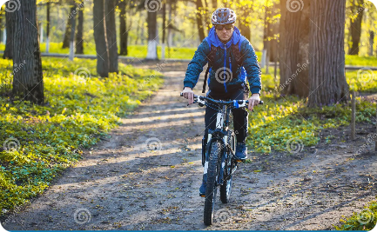
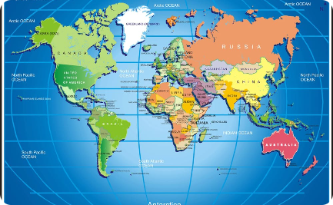
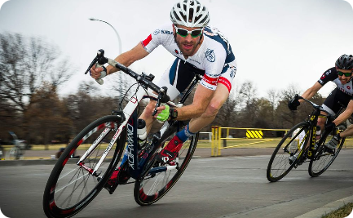
Desired Result
Happier and Healthier Cyclists
Global Impact
Professional Recognition
We believe that our dapp has the potential to transform the way people think about cycling, and we hope to see it adopted by cycling enthusiasts all around the world.
We aim to create a dapp that will inspire and motivate cyclists to go further, explore more, and challenge themselves to achieve new heights of physical health and well-being.
We aspire to gain recognition as a leading innovator in the cycling industry and to be seen as a driving force behind the growth and development of this exciting sport.

Slide 8

Contact Our Team
If you're interested in learning more about our dapp or would like to get involved in this exciting project, please don't hesitate to reach out to our team.

Slide 9

Conclusion
In conclusion, our dapp will be a revolutionary step in the world of cycling, providing users with access to innovative new tools and technologies that will enhance their experiences, foster community, and help them achieve their goals. We're excited to see what the future holds for cycling and for our dapp, and we hope you'll join us on this exciting journey.
Thank you for your time and attention!

